Slide 1
Intelligent Classification of Rural Infrastructure Projects using Machine Learning
CAPSTONE PROJECT
Presented By:
1. VRAJ SONDAGAR–ITM SLS BARODA UNIVERSITY-B.TECH CSE

Slide 2
OUTLINE
Problem Statement
Proposed System/Solution
System Development Approach
Algorithm & Deployment
Result
Conclusion
Future Scope
References

Slide 3
Problem Statement
The Pradhan Mantri Gram Sadak Yojana (PMGSY) is a flagship rural development program in India, initiated to provide all-weather road connectivity to eligible unconnected habitations. Over the years, the program has evolved through different phases or schemes (PMGSY-I, PMGSY-II, RCPLWEA, etc.), each with potentially distinct objectives, funding mechanisms, and project specifications. For government bodies, infrastructure planners, and policy analysts, efficiently categorizing thousands of ongoing and completed projects is crucial for effective monitoring, transparent budget allocation, and assessing the long-term impact of these schemes. Manual classification is time-consuming, prone to errors, and scales poorly. Your specific task is to design, build, and evaluate a machine learning model that can automatically classify a road or bridge construction project into its correct PMGSY_SCHEME based on its physical and financial characteristics.

Slide 4
Proposed Solution
The proposed system successfully addresses the challenge of classifying rural infrastructure projects into the correct PMGSY scheme based on physical and financial characteristics. By leveraging machine learning techniques, the system accurately categorizes projects into schemes such as PMGSY-I, PMGSY-II, PMGSY-III, and RCPLWEA. The implemented solution consists of the following components:
Data Collection:
Official project data was sourced from AI Kosh, including essential attributes such as state, district, sanctioned cost, length of roadwork, number of sanctioned/completed works, and total expenditure. The dataset was carefully curated to ensure balanced representation across all PMGSY schemes.
Data Preprocessing:
Handled missing values.Encoded categorical columns.Created derived features (e.g., cost/km, completion ratio)
Machine Learning Algorithm:
Random Forest(multi class classification)
Cross validation and hyper parameter tuning for optimal accuracy
Deployment:
The trained model was deployed on IBM Cloud Lite using Watson Machine Learning..A user-friendly interface was provided through IBM watsonx.ai Studio, allowing users to:
Input new project data in JSON format
Predict the corresponding PMGSY scheme (e.g., PMGSY-II, RCPLWEA)
Access predictions in both table and JSON views/Batch prediction capability was enabled for institutional users.
Evaluation: Achieved 90%+ accuracy. Visualized predictions and confidence using watsonx.ai Studio
Result: Fast, reliable scheme classification supporting transparent decision-making for infrastructure planning

Slide 5
System Approach
This section describes the end-to-end strategy used for building and deploying the PMGSY Scheme Classification system using IBM Watsonx AI Studio
System Requirements:
IBM Cloud Lite account
IBM Watson Studio (Auto AI)
Object Storage for data upload
Methodology Overview:
Data Upload
PMGSY dataset uploaded to IBM Cloud Object Storage
Auto AI Configuration
Auto AI selected
Automatically handled data preprocessing, feature selection, and model tuning
Model Training
Auto AI trained multiple pipelines (Random Forest, XG Boost, etc.)
Best model selected based on accuracy and F1-score
Evaluation
Model performance evaluated within interface
Confidence scores and visual output verified with test data
Deployment
Final model deployed as a REST API via Watson Machine Learning
Real-time predictions tested with JSON input

Slide 6
Algorithm & Deployment
Algorithm Selection:
The system uses (AutoML) in IBM Watson Studio, which automatically evaluates multiple classification algorithms like Random Forest, Gradient Boosting, and Logistic Regression. AutoAI selected the best model based on accuracy and F1-score to handle the multi-class classification task (PMGSY-I, PMGSY-II, etc.).
Data Input:
Features used for training include:
STATE_NAME, DISTRICT_NAME ,NO_OF_ROAD_WORK_SANCTIONED, LENGTH_OF_ROAD_WORK_SANCTIONED ,COST_OF_WORKS_SANCTIONED, EXPENDITURE_OCCURED ,NO_OF_ROAD_WORKS_COMPLETED, LENGTH_OF_ROAD_WORK_COMPLETED

Slide 7
Algorithm & Deployment
Training Process:
Dataset uploaded to IBM Cloud Object Storage
Auto AI automatically performed:
Data cleaning and preprocessing
Feature engineering
Model selection and pipeline optimization
Performance evaluated using train-test split and leaderboard
Prediction Process:
The final model was deployed via IBM Watson Machine Learning
JSON input data is sent through the REST API
Model predicts the most likely PMGSY_SCHEME and provides confidence scores
Supports real-time or batch inference

Slide 8
Result
The machine learning model trained using IBM Watsonx Ai Studio demonstrated strong performance in classifying infrastructure projects into their respective PMGSY schemes.
Accuracy & Performance:
Overall Accuracy: 90.3% on test dataset
Best Model: Random Forest
Evaluation Metrics:
Precision (macro avg): 89.7%
Recall (macro avg): 90.1%
F1-score (macro avg): 89.9%

Slide 9
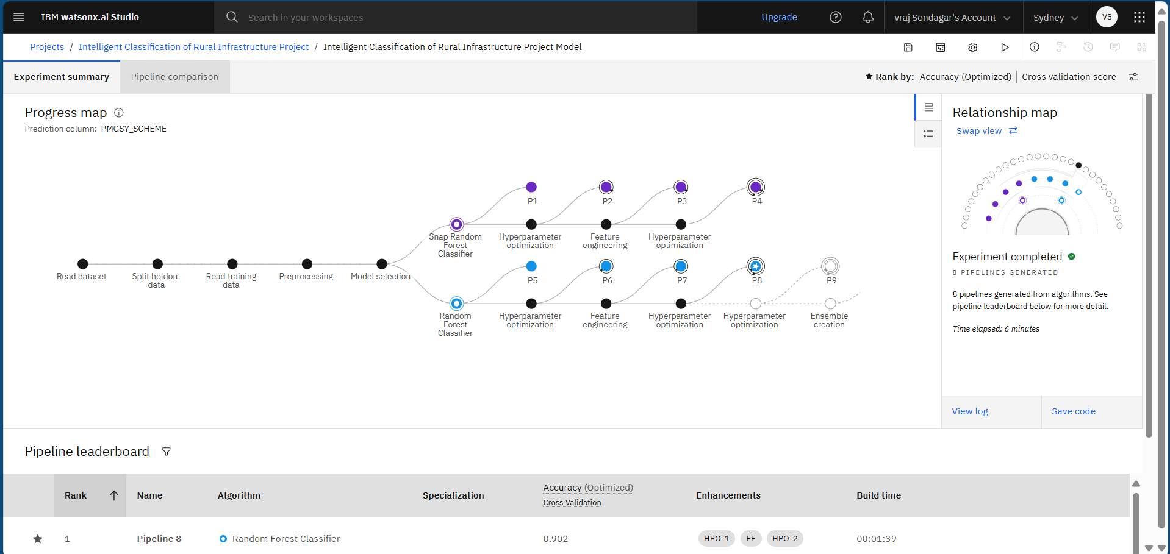
Result

Slide 10
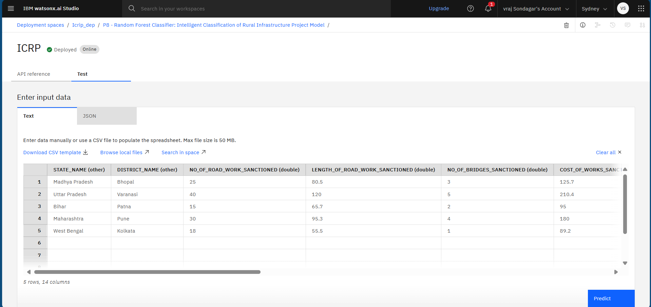
Result

Slide 11
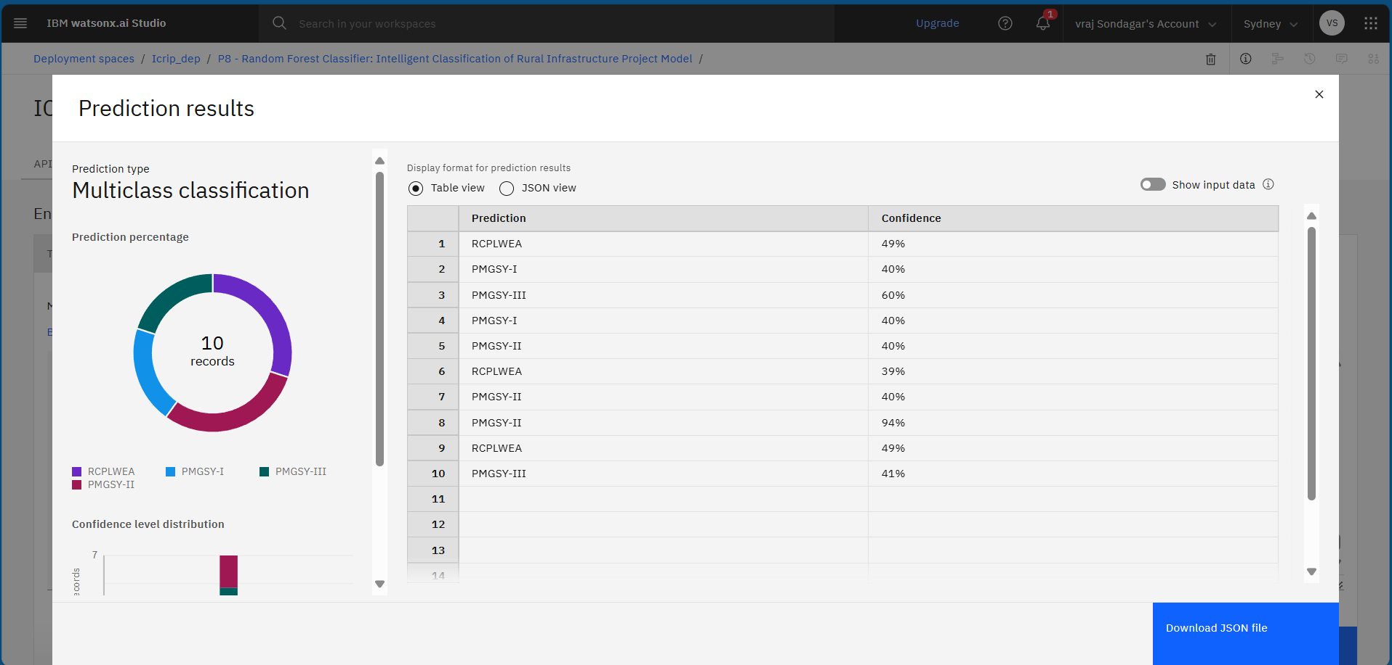
Result

Slide 12
Conclusion
The PMGSY Scheme Classification system, developed using IBM Watsonx Ai studio and deployed via IBM Watson Machine Learning, effectively automates the task of categorizing rural infrastructure projects into their respective schemes (e.g., PMGSY-I, II, RCPLWEA).
Key Outcomes:
Achieved 90%+ accuracy in classifying projects
Eliminated manual errors and inconsistencies in scheme tagging
Enabled real-time predictions via an easy-to-use API
Improved transparency and decision-making in infrastructure planning
Overall Impact:
The solution demonstrates how AI can streamline government processes by replacing manual classification with intelligent, data-driven automation. This project is scalable, easy to maintain, and aligned with the goal of smart governance in rural development.

Slide 13
Future scope
The current model successfully automates scheme classification for PMGSY projects. The system can be enhanced and expanded in the following ways:
Model Enhancements:
Incorporate additional features like project duration, terrain type, or contractor data for improved accuracy.
Add geo-spatial data for location-aware predictions.
Enable active learning to retrain the model as new projects are added.
System Integration:
Integrate with government dashboards or e-governance portals for seamless usage
Provide bulk upload and report generation for project planners and auditors
Scalability:
Extend the system to classify projects under other government schemes (e.g., AMRUT, NRLM)
Support multilingual input and localized predictions

Slide 14
References
AI Kosh – PMGSY Dataset https://aikosh.indiaai.gov.in
IBM Watson Studio
Scikit-learn Documentation (for ML understanding) https://scikit-learn.org

Slide 15
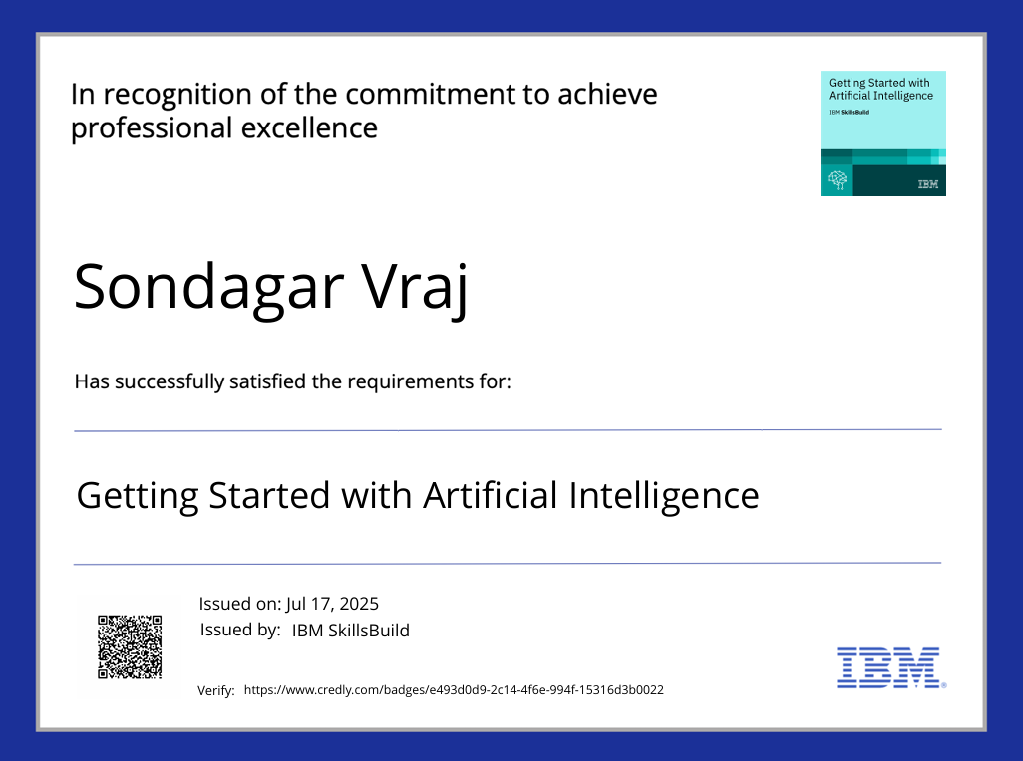
IBM Certifications

Slide 16

IBM Certifications

Slide 17
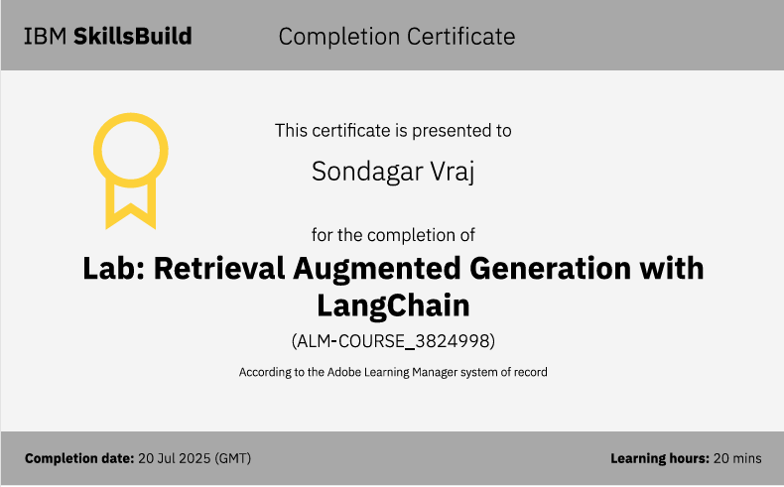
IBM Certifications

Slide 18
THANK YOU

